Slide 1
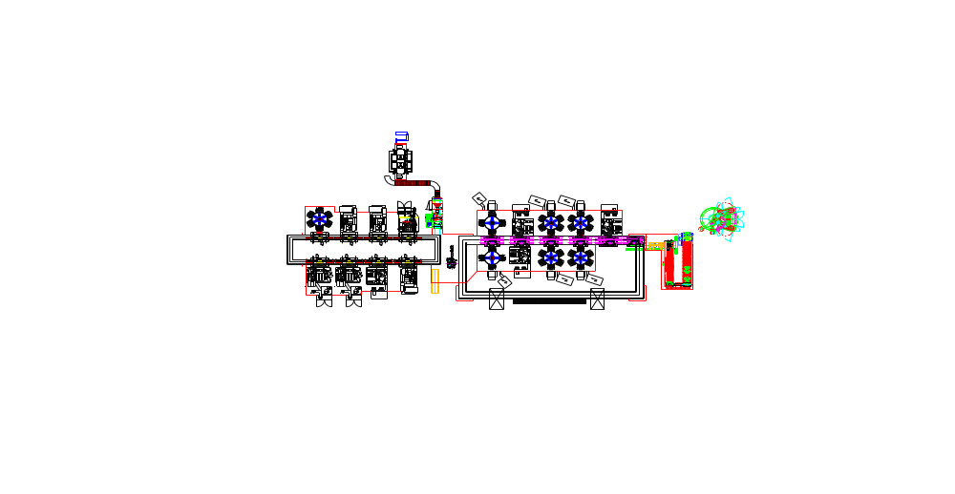

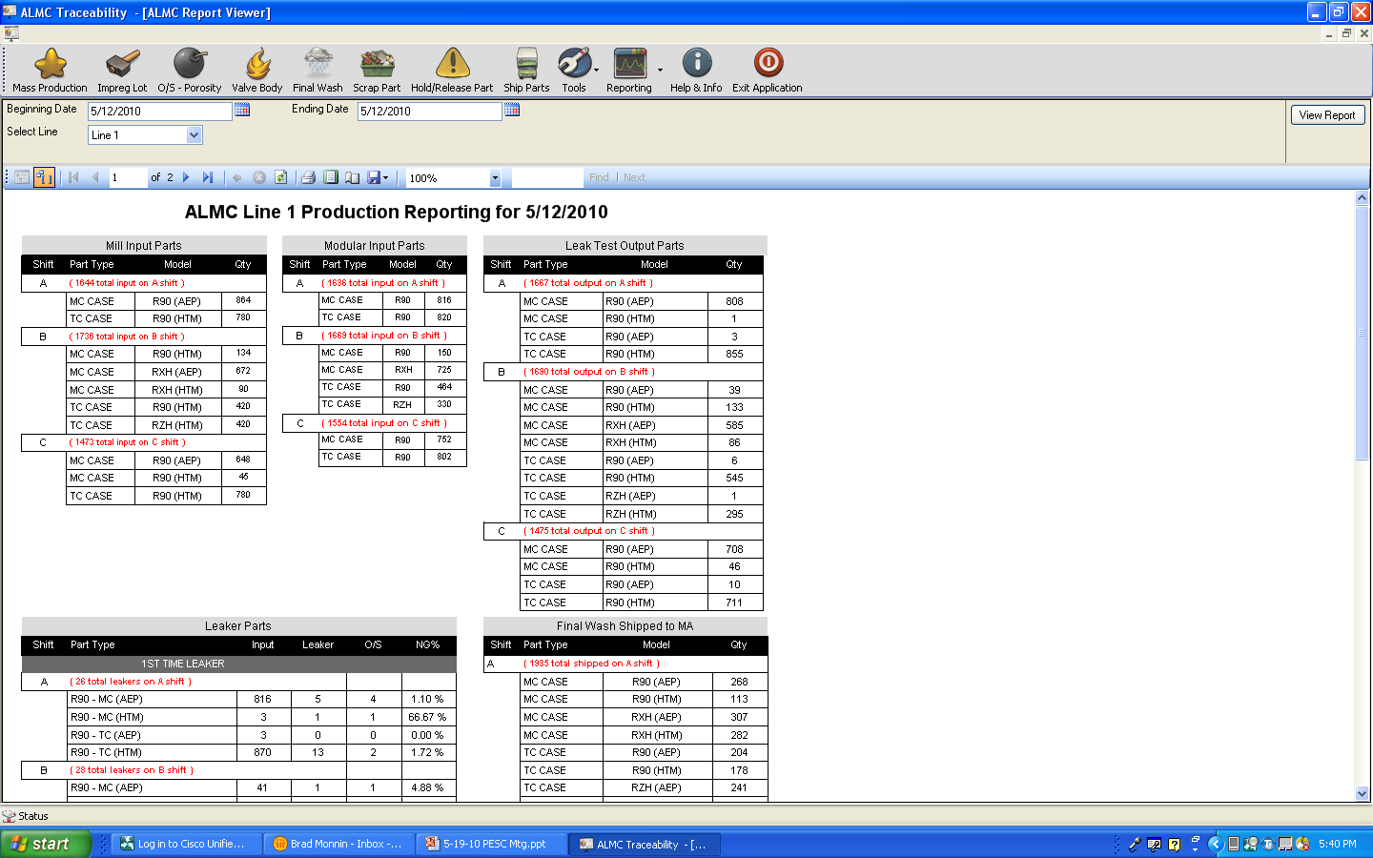
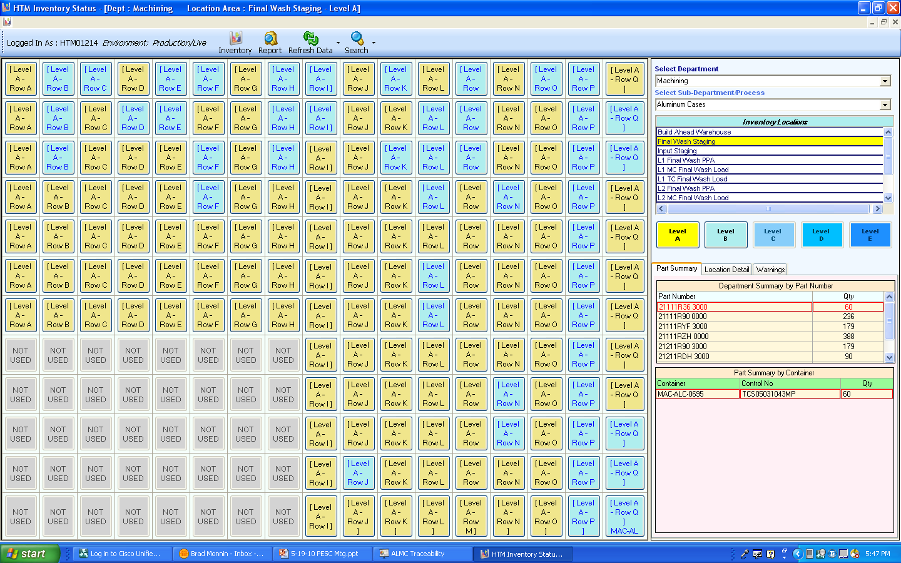
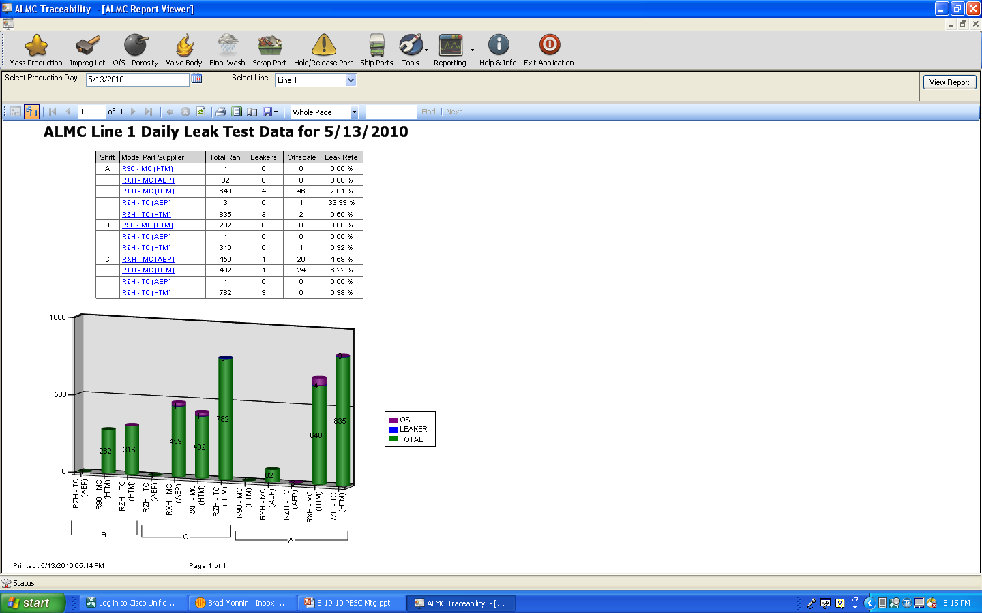
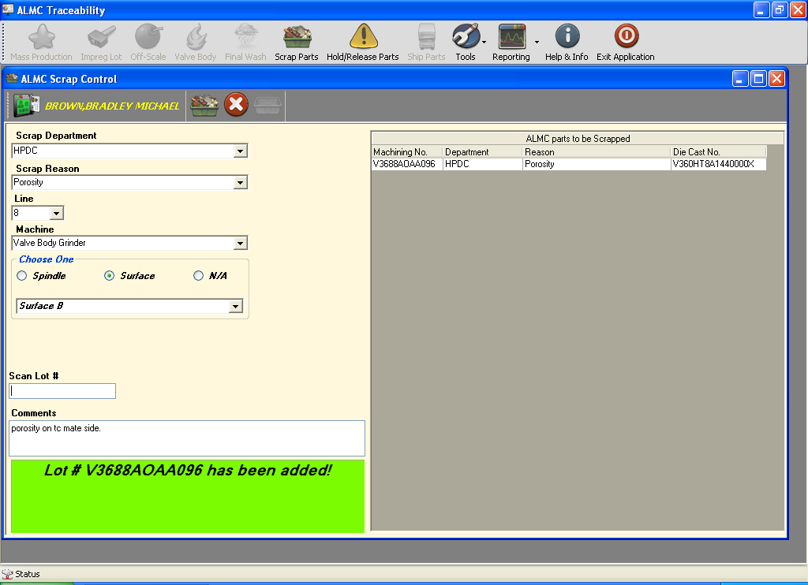
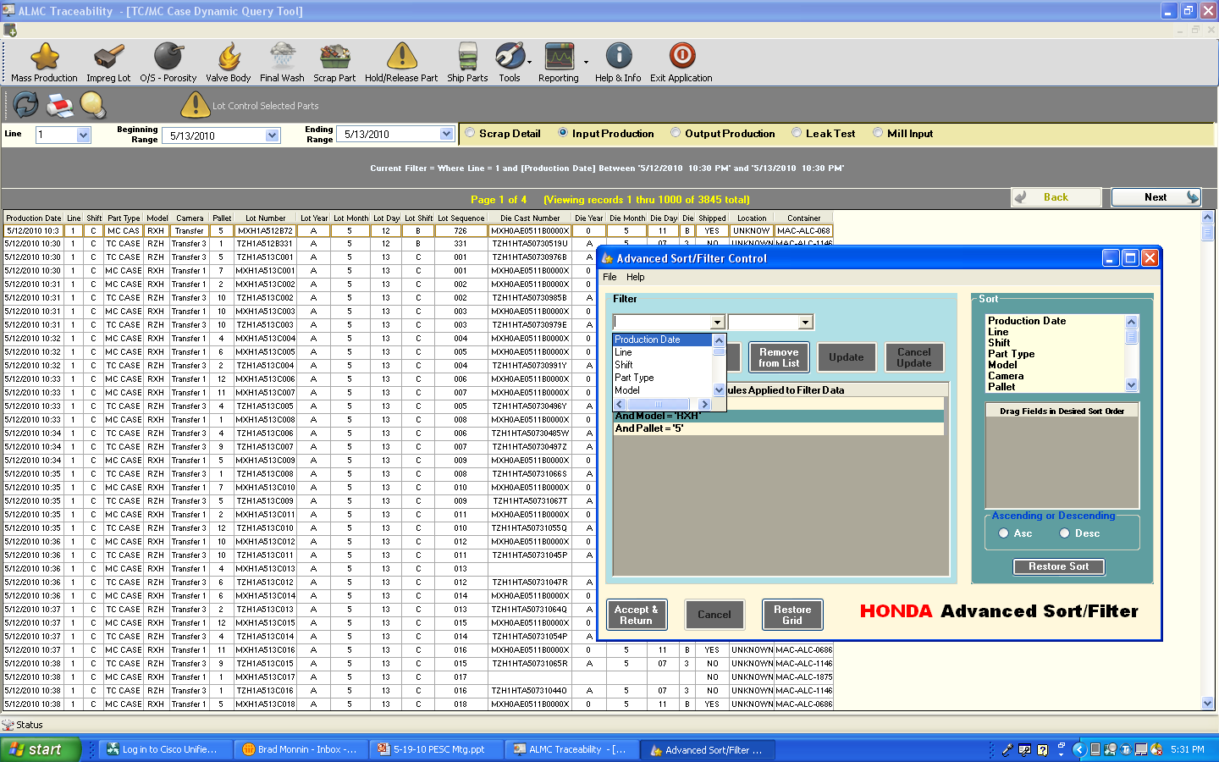
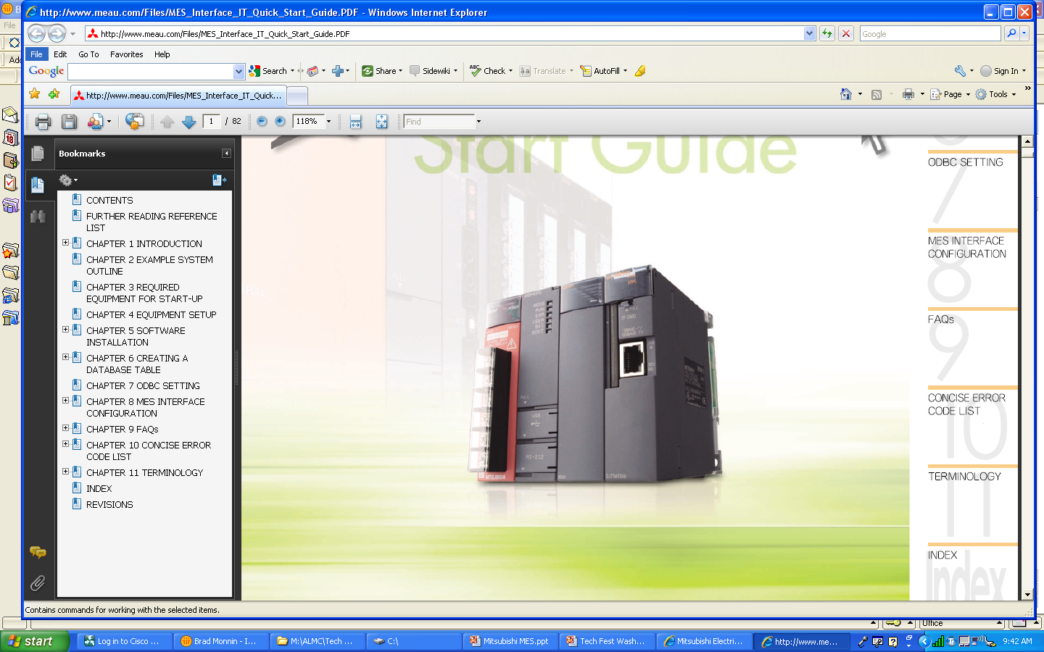
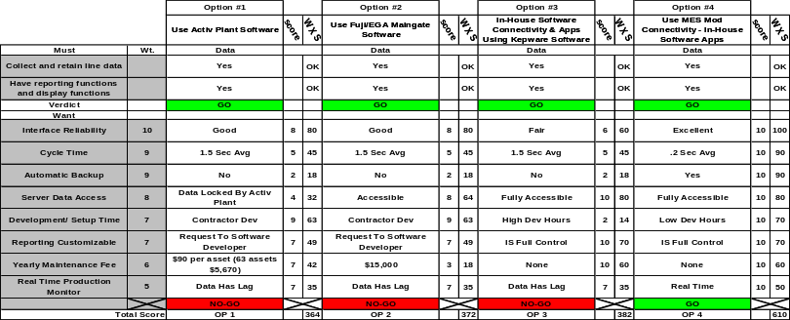
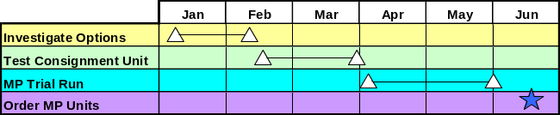
Plant: HTM
Traceability Mitsubishi
MES Module Connectivity
Plant Manager
Dept. Manager
Team Member
Department: ALMC
Theme Title
Brad Sapp
Brad Monnin
Entry Date: 8-18-10
Purpose:
Provide Method For Connection Between Factory Floor PLC And SQL Database For part Traceability Information Collection
Current Situation:
When the traceability project was being designed there was a need to collect the data from the factory floor to the SQL database.
What Is Best Connection Method ???
SQL Database
Centralized PLC System
Collects All Line Data
Production Reports
Any HTM Network PC Can Access Over 50 Reports Using In-house Developed Applications That Pull From The Database
Inventory Reports
Data Collection Points
PLC To PLC Communication Paths
Leakrate Reporting
Scrap/Hold Reporting
Lot Control Queries
Objective:
Provide A Simple, Fast, And Reliable Bi-Directional Connection Between The Factory Floor PLC And The SQL Database To Achieve Real Time Part Traceability Information
New Idea / Technical Concept
Use A MES (Manufacturing Execution System) Interface Module
New product From Mitsubishi For Factory Floor Connectivity
Benefits Of The MES Interface Module
- Reduced Complexity Of Interface & Reduced System Development Time
- Direct Connection To Database
- System Reliability Has Been Excellent
- Reduce Interface Time – 1.0-3.0 Seconds To .2 Seconds
- Provides Automatic System Backup & Retrieval For Server Connection Problems
- Able To Synchronize Server And Plc Clocks For Accurate Data Collection
- No Database Access Issues (No Need For Duplicate Database)
- One Module Can Handle Data For Entire Line
- Simple System Setup Of MES Module Uses PC Based System Software Tool
- Data Handshake Ready & Complete Signals Are Easily Setup In PLC Ladder Code.
Honda Usage
- HTM Was First US Company To Put Into Operation
- HTM Has 8 Working Units And 11 More Scheduled Before End Of Ki
- Interface Module Is Now HTMs Standard & Is Used In AP As Well As ALMC
- Can be used anywhere connectivity is required and Mitsubishi PLCs are supported
Patentable:
Yes No
Engineering Analysis & Methodology```
Other Ideas
Considered …
Testing Results
Connection Method: Direct To SQL Database
Speed (Line Cond.): 100 Saves In 19.97 Sec (.2 Sec)
Reliability: 1.5 Months - No Connection
Failures
Automatic Backup: Back-Up To CF 2 Gig
Database Access: Full Access
Throughput: 30 Text & 30 Numerical
Setup: Simple & Fast
PLC Interface: 2 Handshake Signals
Synchronized Clocks: PLC To Server
Implementation & Resources
Impact & Benefit
Cost: Reduced IS Interface Develop Cost (120 Hrs).
Reduced System Setup Time Cost (40 Hrs)
Avoidance $185,000 Per Year (1.3 Sec CT Inc)
Delivery: Reliability excellent (No downtime reported to date)
MP maintained if server connection down (CF backup)
Minimal line cycle time increase (Due to connection speed)
E2: E3:

